Slide 1
Time Series Forecasting using R
Neural Network Approach
Prasun Biswas
Shuvayon Dey

Slide 2
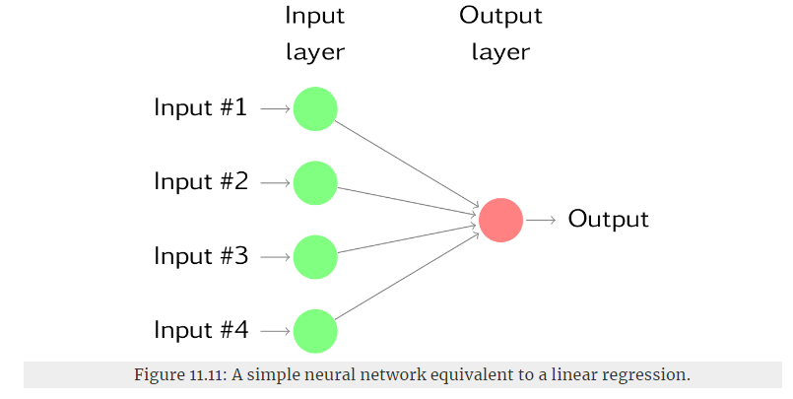
Overview
The Neural Network algorithm is based on the biological activity of the brain, where neurons are interconnected and learn from experience.
They are highly data driven and computationally expensive.
Their structure is highly complex an the relationship they capture is difficult to interpret.
Mostly useful when we need to generate automated forecasting where minimal explanatory analysis is involved.

Slide 3
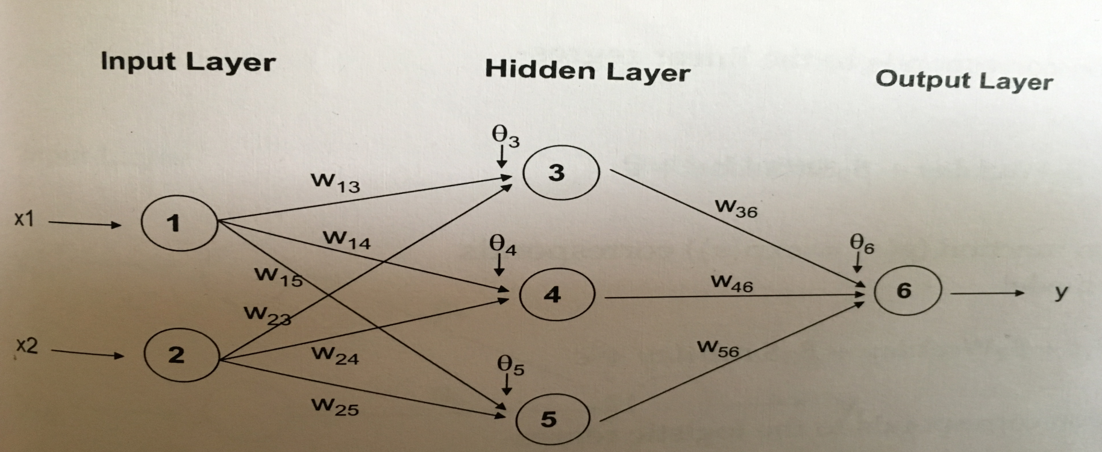
Neural Network – Time Series Forecasting (1/3)
A neural links the set of predictor and outcomes through a sequence of layers. In each layer some operation is performed on the input information to produce an output. The output of each layer is input to the next.
A neural network consists of three layers:
An input layer receives the input values of predictors.
One or more hidden layers create derived variables. A hidden layer receives inputs from the previous layer, performs a calculation on those inputs, and generates an output.
An output layer receives inputs from last hidden layer and produces forecasts.

Slide 4
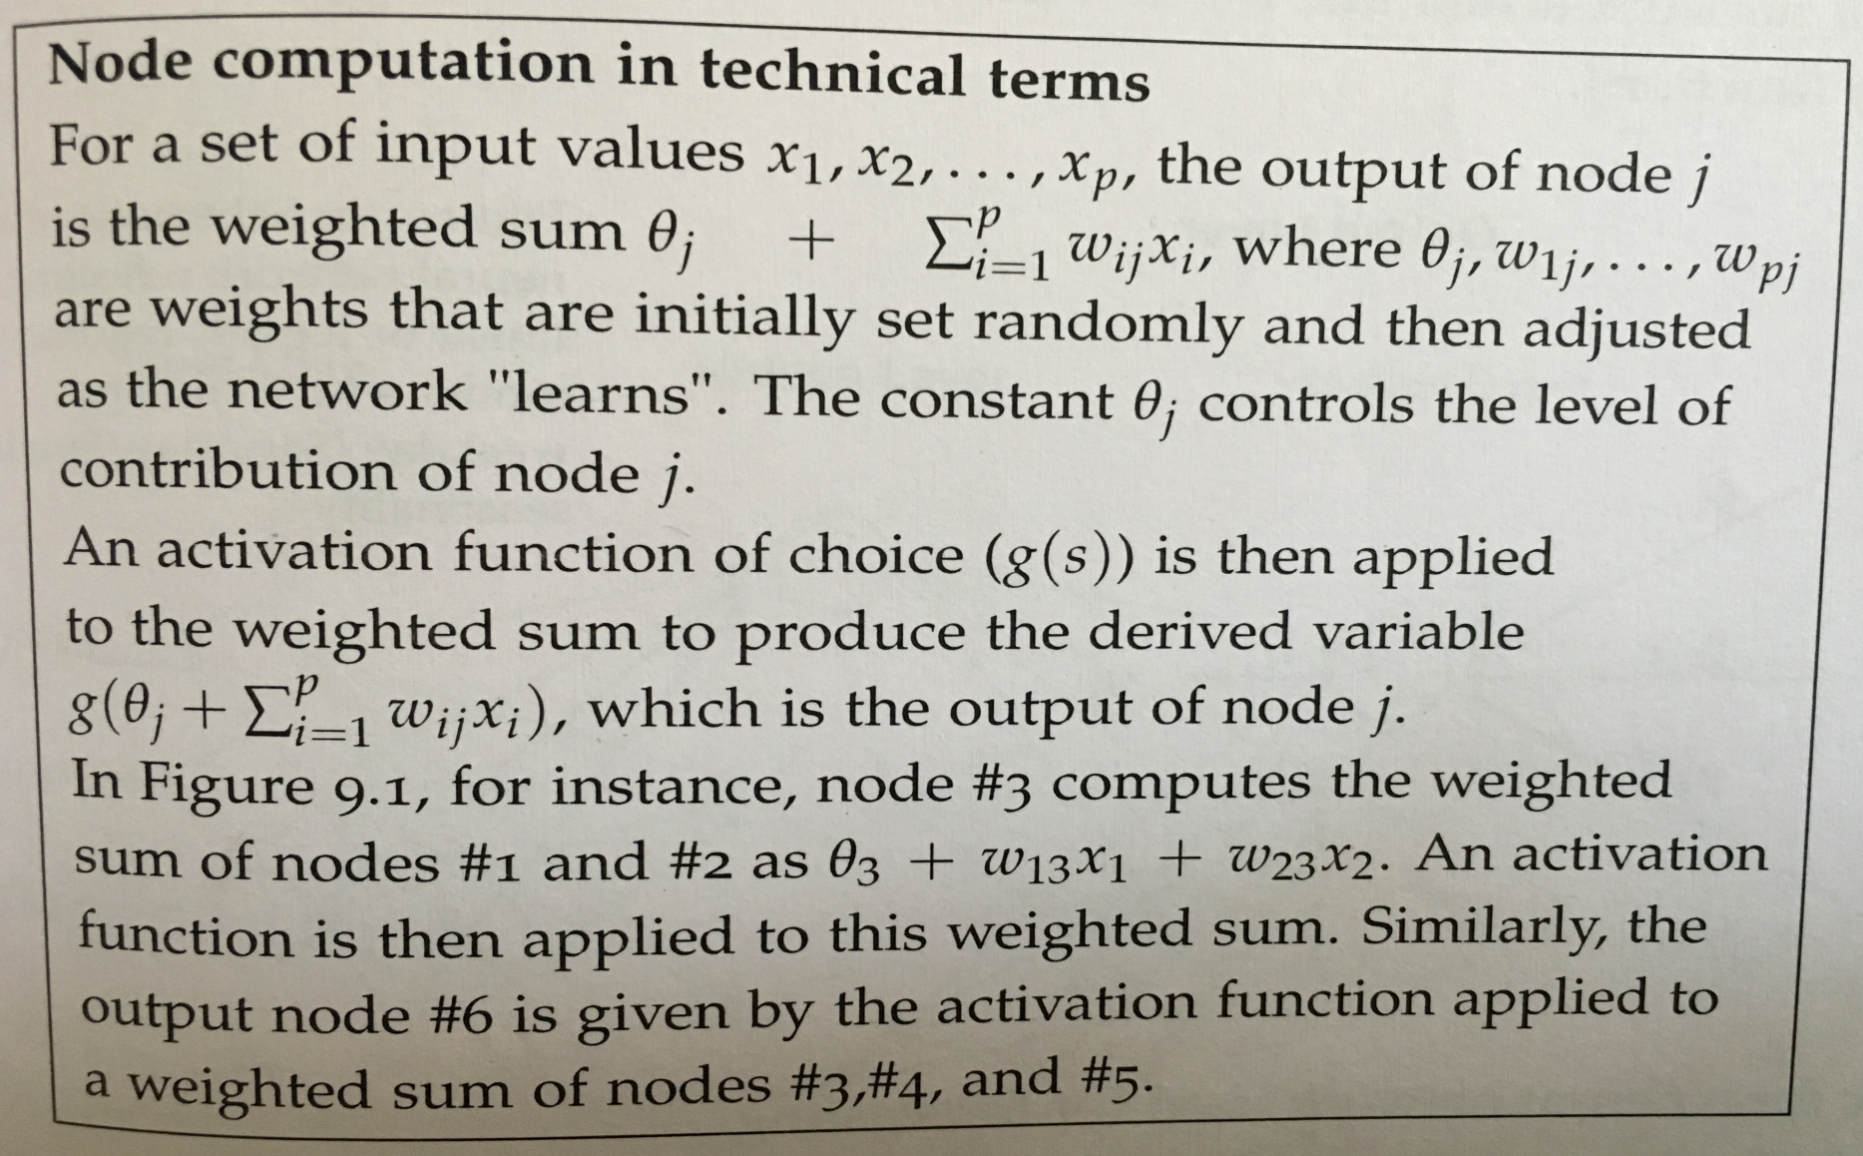
Neural Network – Time Series Forecasting (2/3)

Slide 5
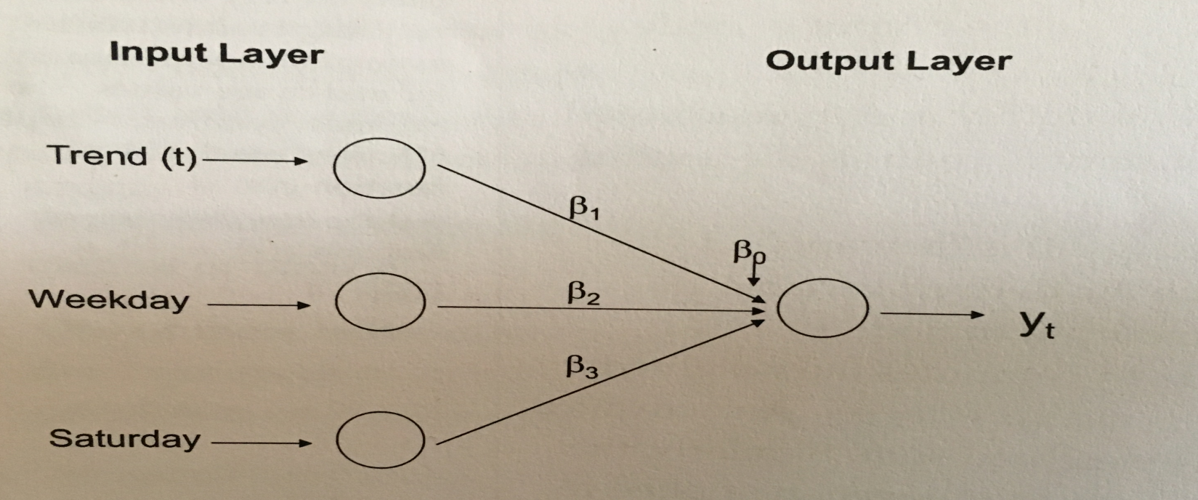
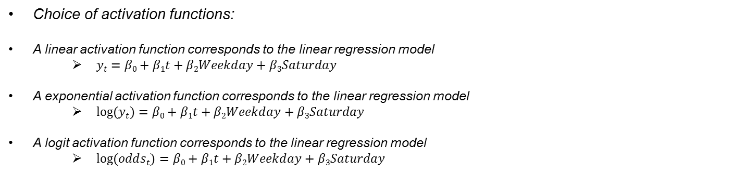
Neural Network – Time Series Forecasting (3/3)
Choice of activation functions:
A linear activation function corresponds to the linear regression model
$yt=β0+β1t+β2Weekday+β3Saturday$
A exponential activation function corresponds to the linear regression model
$log⁡(yt)=β0+β1t+β2Weekday+β3Saturday$
A logit activation function corresponds to the linear regression model
$log⁡(oddst)=β0+β1t+β2Weekday+β3Saturday$

Slide 6
Pre – Processing Steps
Creating derived Variables: We can create predictors such as lagged version of time series, lagged version of external variables, seasonal information and time index to capture trend.
Missing Value treatment: When creating lagged version of predictors, rows with missing values must be taken care of.
Scaling: Neural networks works best when the predictor variables are scaled between [0,1] or [-1,1]. Hence in time series context, the series itself as well as the predictors should be scaled before running neural network.
When the predictors are lagged version of the series itself, scaling to [-1,1] cab be achieved by dividing with range of the series.
Removing trend and seasonality: There have been mixed reports in literature regarding the need to remove trend and seasonality prior to using neural networks. Some claim that removing neural network can account for both trend and seasonality while substantial empirical evidence suggests that de-trending and de-seasonalizing improve the performance of neural networks.

Slide 7
User Input
The number of input nodes is equal to the number of predictors and is therefore problem dependent. Generally, the more input nodes, the less time it takes for the network to train on.
The number of hidden layers affects the level of complexity of relationships between the input and the output. Typically, 1-2 layers are sufficient. Using too few may lead to under-fitting while too many may lead to over-fitting.
Choice of activation functions may be between linear, exponential and logistic.
The number of outputs nodes depend on the number of forecasts that we want to generate.
There are generally two functions widely used for forecasting using neural nets, avNNet (caret package) and nnetar (forecast package).

Slide 8
R functions
avNNet | nnetar
avNNet function fits several neural networks and then averages their values to produce an ensemble forecast. | nnetar first peforms a series of pre-processing steps before calling the avNNet function.
More useful when we are working with generic predictors or seasonal dummy variables (weekdays, weekends, tax season, holidays etc.) | nnetar applies to time series where the only predictors are lagged version of the series itself.
Need to perform missing value imputation as pre-processing | nnetar takes care of missing value imputation on its own.
Need to manually scale all predictor as well as original series to [0,1] or [-1,1] | Automatically scales the series.
A NNAR(9,5) model is a neural network with the last nine observations (y_{t−1},y_{t−2},…,y_{t−9}) used as inputs to forecast the output y_{t}, and with five neurons in the hidden layer. A NNAR(p,0) model is equivalent to an ARIMA(p,0,0) model but without the restrictions on the parameters to ensure stationarity.
An NNAR(3,1,2)₁₂ model has inputs y_{t−1}, y_{t−2}, y_{t−3} and y_{t−12}, and two neurons in the hidden layer.
Notes:
nnetar(y, p, P = 1, size, repeats = 20, xreg = NULL, lambda = NULL, model = NULL, subset = NULL, scale.inputs = TRUE, x = y, ...)
Arguments
y - A numeric vector or time series of class ts.
p - Embedding dimension for non-seasonal time series. Number of non-seasonal lags used as inputs. For non-seasonal time series, the default is the optimal number of lags (according to the AIC) for a linear AR(p) model. For seasonal time series, the same method is used but applied to seasonally adjusted data (from an stl decomposition).
P - Number of seasonal lags used as inputs.
Size - Number of nodes in the hidden layer. Default is half of the number of input nodes (including external regressors, if given) plus 1.
Repeats - Number of networks to fit with different random starting weights. These are then averaged when producing forecasts.

